Slide 1
Azure Machine Learning from zero to hero
Lucas De Carli
Cloud Architect

Slide 2
If Statements from zero to hero
Lucas De Carli
Cloud Architect

Slide 3
Azure Machine Learning from zero to hero
Lucas De Carli
Cloud Architect

Slide 4

The need to know what could be…

Slide 5
Intro
“AI is the new electricity. Just as 100 years ago electricity transformed industry after industry, AI will now do the same.”, Andrew Ng.
Notes:
Andrew Yan-Tak Ng is Chief Scientist at Baidu Research in Silicon Valley.

Slide 6
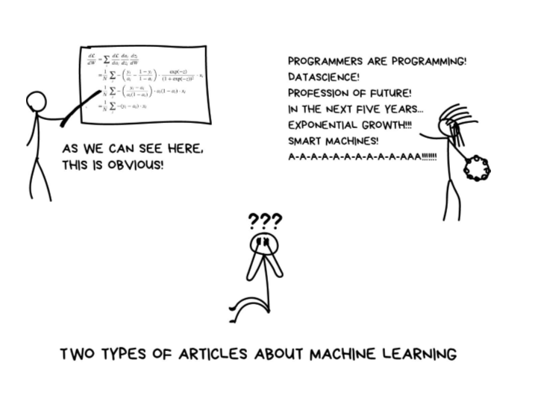
What is Machine Learning ?

Slide 7
What is Machine Learning ?
Using known data, develop a model to predict unknown data.
Notes:
Basic definition:
Machine learning develops algorithms for making predictions (statistical sense) from data *
Learning models from available training data, to make good predictions on unseen test data
Types of Machine Learning: Supervised, Unsupervised, Reinforcement (Apprentissage Supervisé, Apprentissage Non Supervisé, Apprentissage de Reenforcement)

Slide 8
Microsoft & Machine Learning
1997
2008
2009
2010
2014
2015
Hotmail launches
Which email is junk?
Bing maps launches
What’s the best way to home?
Bing search launches
Which searches are most relevant?
Kinect launches
What does that motion “mean”?
Skype Translator launches
What is that person saying?
Azure Machine Learning GA
What will happen next?
Notes:
More than a decade, Microsoft is using ML in its services.

Slide 9
Timeline
MIT Labs for AI
Machine Learning Theory
1950
1974-80
1982
1960
1980
Starts of AI
AI Winter
Machine Learning & IA
Notes:
1950 – Alan Turing
1956 - Dartmouth Allen Newell, Herbert Simon-> Logic Theorist
1957 - General Problem Solver
1982 – Machine Learning se mista

Slide 10
Timeline
Kernel Methods &
Deep Learning
GPUs avaiability
1989
2006
2017
2000
2015
Machine Learning
Modern Deep Learning
Quantum computing SDK
Notes:
1989 – Evolver – Primeiro software para pc com algoritmos genéricos
2000 – Igor Aizenberg falou a primeira vez a palavra quando falava sobre Artificial Neural Networks (ANNs)
2009 - ImageNet
2010 - Aprendizado Supervisionado
Aprendizado Não-Supervisionado
Aprendizado por Recompensa

Slide 11
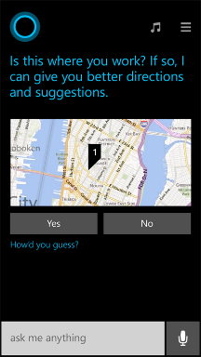
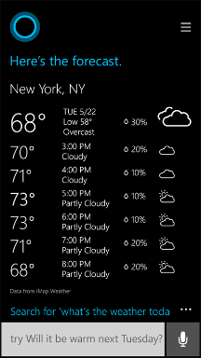
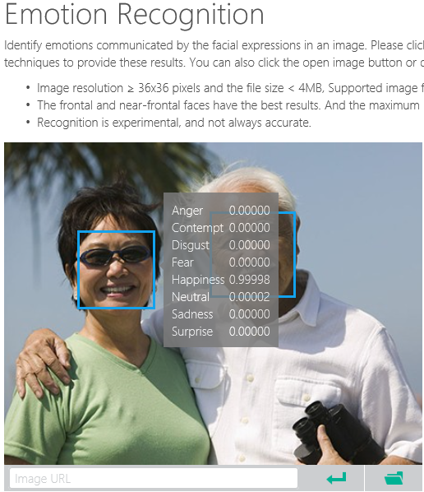
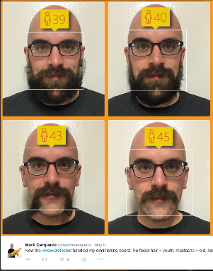
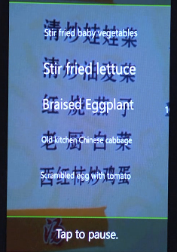
Why Machine Learning?
Notes:
Smart applications, services, platforms…
Digital Smart Personal Assistant
Image / Text / Data analyze

Slide 12
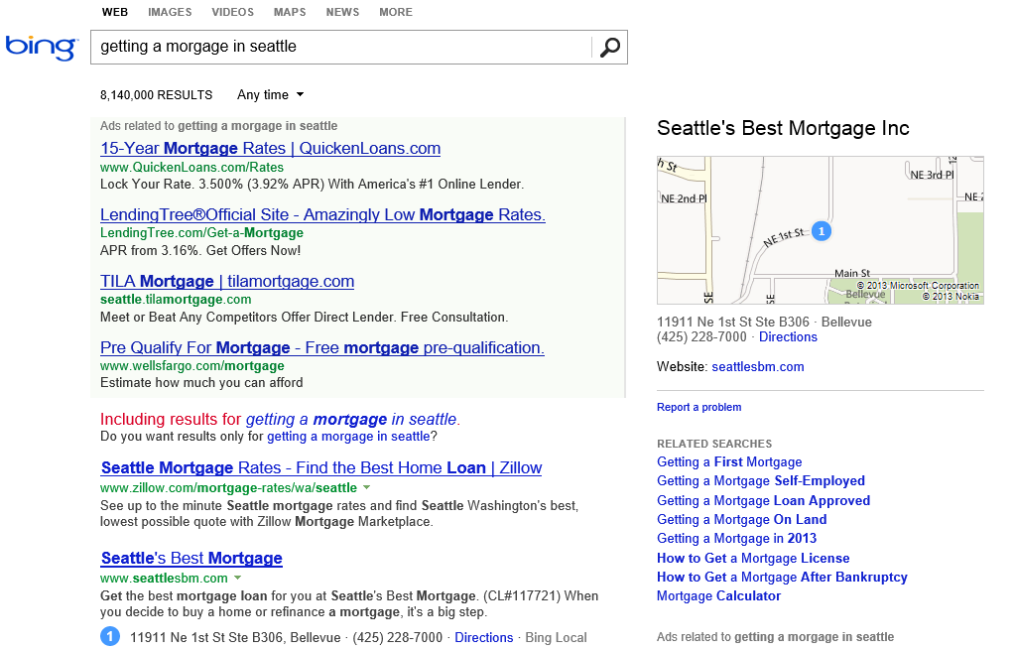
What is the probability of a click on each ad?
What language?
What is the intent?
Machine learning enables nearly every value proposition of web search.
Which ads to show, and in what order?
Are any of these pages malicious?
Misspelled?
What pages should we index?
What ad pricing will optimize revenue?
Which links are most likely to get clicked?
Notes:
The first “killer commercial application” of ML on Big Data was web search. With ML, we can use all of the billions of queries and associated clicks that we collect each month as training data for an ML system. That way, the system can learn, for each query, which web pages are likely the most relevant.
But the impact of ML goes beyond page relevance. With billions of queries, we can learn common misspellings and the native language of the user. We can discern the intent of the user – shopping? research? entertainment? ML can learn what kinds of pages are malicious.
ML also is able to learn, for each query, what kinds of ads are most likely to be clicked, and also learn how best to show the ads.
And even before we get to a real user, ML can be used to figure out what parts of the web are worth scanning, and what pricing for ads will optimize revenues.

Slide 13
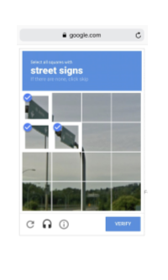
Collect Data

Slide 14
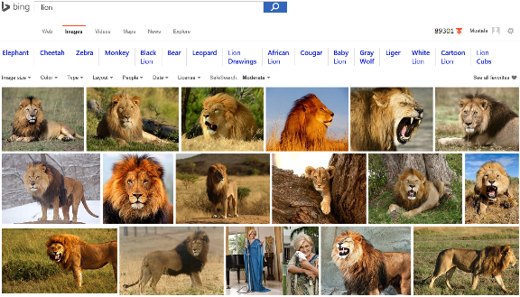
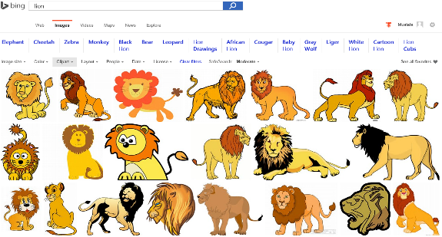
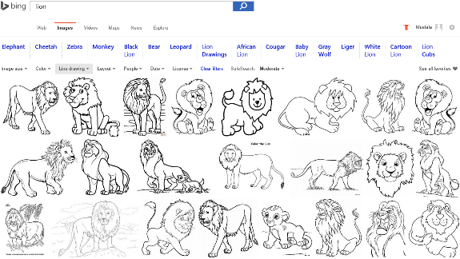
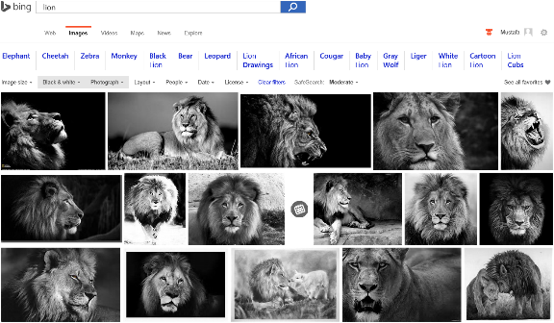
Image Analyze
Notes:
Search “lions” on Bing and change Image type etc. filters…
Behind the ML service categorizes the image db and returns the result.

Slide 15

Accent Color: Which border color is the best?
Notes:
Some another application on computer vision that meets with the machine learning

Slide 16
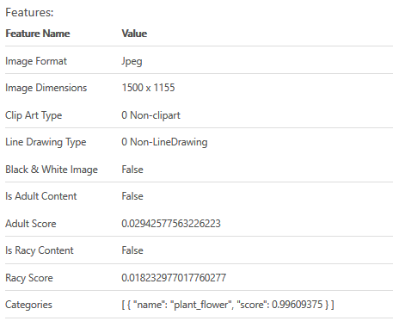

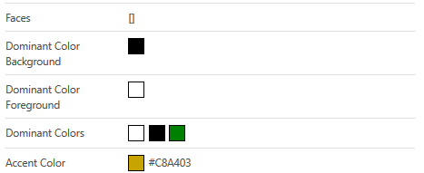
Accent Color: Analyze Image
Notes:
Goto https://www.projectoxford.ai/demo/visions#Analysis and analyze this image to find its accent color

Slide 17
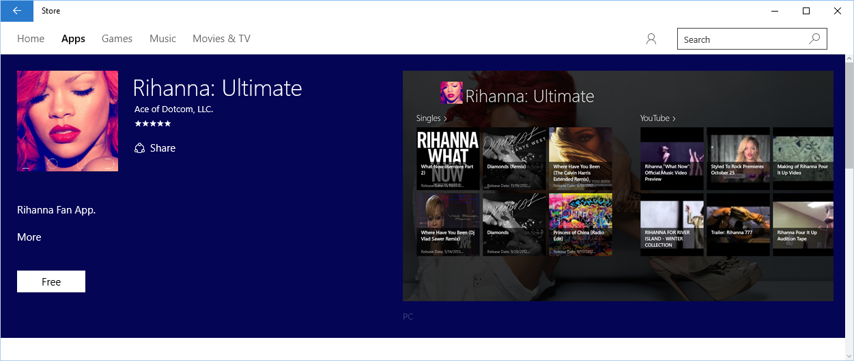
Accent Color: Windows 10 Store
Notes:
How to use accent color, case study.

Slide 18
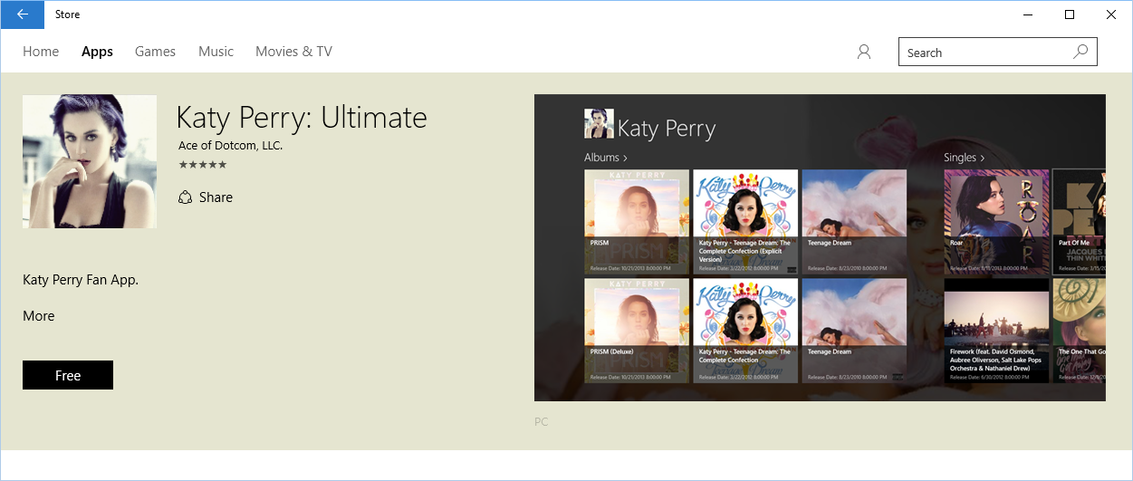
Accent Color: Windows 10 Store
Notes:
How to use accent color, case study.

Slide 19
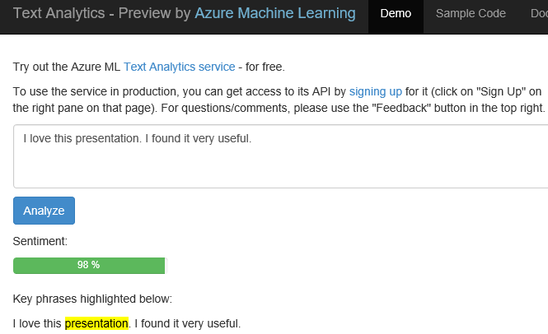
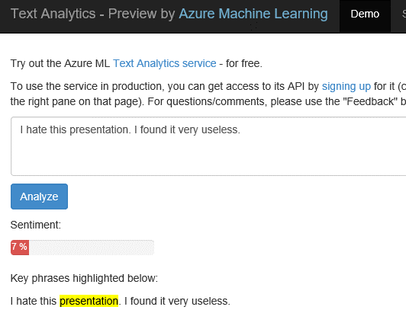
Text Analytics: User reviews
Positive
Negative
Notes:
Ready to use ML API published on Azure Datamarket place. A showcase of production ML solution in action (This can be used i.e. in shopping websites to see user reviews about a product etc.)
Test by yourself some of the reviews comments on Expedia or other online shopping sites. Copy/paste user comments to see the analyze result. If sentiment result shows higher percentage number, it means it is positive. If the percentage is low than it is a negative comment.
https://text-analytics-demo.azurewebsites.net/

Slide 20
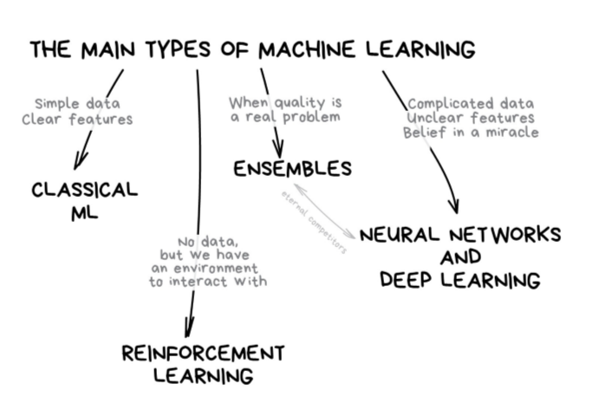
Types of Machine Learning

Slide 21
From data to decisions and actions
Data
Recommendations
What should I do?
Decision
Action
Decision automation
Decision support
Predictions
What will happen?
Interactive dashboards
Why did it happen?
Static reports
What happened?
Manual process
Value
Notes:
Azure ML aims to transform your data in to an intelligent action

Slide 22
Microsoft Azure Machine Learning
ML Algorithms
Best of MS
ML Studio
Data Scientist
ML APIs Marketplace
IT Professional
Cognitive Services APIs
ISVs & Developers
Notes:
How customers generally benefit from Azure ML

Slide 23
What is Machine Learning ?
Using known data, develop a model to predict unknown data.
Known Data: Big enough archive, previous observations, past data
Unknown Data: Missing, Unseen, not existing, future data
Model: Known data + Algorithms (ML algorithms)
Notes:
Basic definition:
Machine learning develops algorithms for making predictions (statistical sense) from data *
Learning models from available training data, to make good predictions on unseen test data
Highlight the keywords: Known Data, Model, Unknown Data and the Prediction (statistically…)

Slide 24
EXAMPLE 1

Slide 25
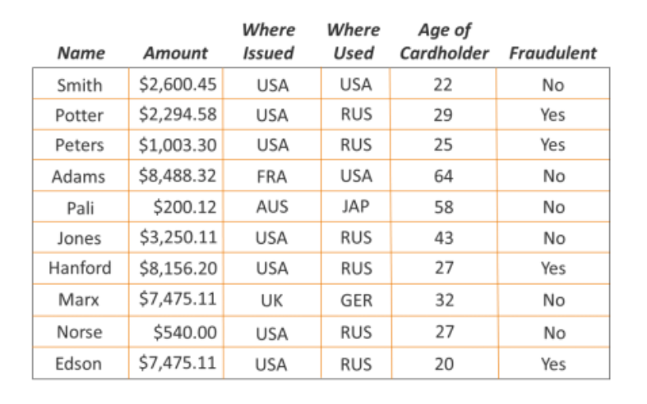
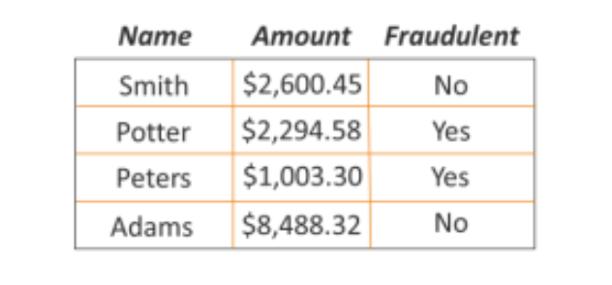
Human Analyses
Notes:
FEATURES AND LABELS

Slide 26
EXAMPLE 2

Slide 27




Known data
Model
Unknown data
…
…
…
…
…
1990
50°F
30°F
68°F
95°F
48°F
29°F
70°F
98°F
2000
Weather forecast sample
2010
49°F
27°F
67°F
96°F
2020
?
?
?
?
Using known data, develop a model to predict unknown data.
Notes:
Weather forecast sample:
- You have previous weather data
- You build your ML model based on existing data
- Based on the model you developed, make good predictions about future

Slide 28



Model (Regression)
90°F
1990
50°F
30°F
68°F
95°F
Predict 2020 Summer
2000
48°F
29°F
70°F
98°F
2010
49°F
27°F
67°F
96°F
-26°F
Using known data, develop a model to predict unknown data.
Notes:
Using appropriate algorithms with the existing data, we generate a mathematical model, formulation or define a pattern to predict future, unknown values
Highlight the keywords: Known Data, Model, Unknown Data and the Prediction (statistically…)

Slide 29
EXAMPLE 3

Slide 30

Model (Classification)
Classify a news article as (politics, sports, technology, health, …)
Politics
Sports
Tech
Health
Using known data, develop a model to predict unknown data.

Slide 31
Known data (Training data)
Documents
Labels
Tech
Health
Documents consist of unstructured text. Machine learning typically assumes a more structured format of examples
Politics
Politics
Process the raw data
Sports
Using known data, develop a model to predict unknown data.

Slide 32
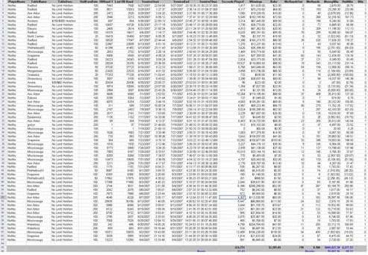
Known data (Training data)
Documents
Labels
Process each data instance to represent it as a feature vector
Tech
Documents
Labels
Health
Feature
Politics
Politics
Sports
Using known data, develop a model to predict unknown data.

Slide 33




Developing a Model
Training data
Base Model
Documents
Labels
Feature Vectors
Tech
Adjust
Parameters
Health
Politics
Train the Model
Politics
Sports
Using known data, develop a model to predict unknown data.

Slide 34


Model’s Performance
True
labels
Predicted
labels
Detach
Model’s
Performance
Difference between “True Labels” and “Predicted Labels”
+/-
Known data with true labels
Tech
+/-
Tech
Health
Health
Politics
Politics
Politics
Politics
Tech
Health
Test data 20%
+/-
Sports
Sports
Politics
Politics
Split
Compare prediction
with true labels
Test trained model with features
Training data 80%
Tech
Health
Politics
Train the Model
Sports
Politics
Sports
Notes:
Ratio of the Test/Training data is trivial. Depends on model, data size, quality etc.
Split is random (i.e. which %80 portion of the data?)
There is no rule to split into %80 & %20 … it might be %50 & %50 etc depending on the problem, model, case.
If you are not happy with the Model’s performance than adjust the parameters and re-train the model. Or change the algorithm (training approach) behind the method…

Slide 35
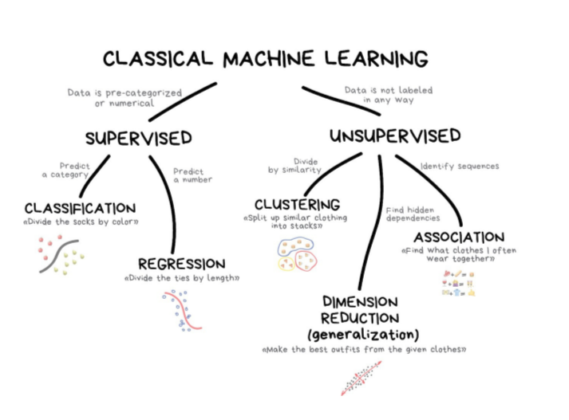
Classical ML

Slide 36
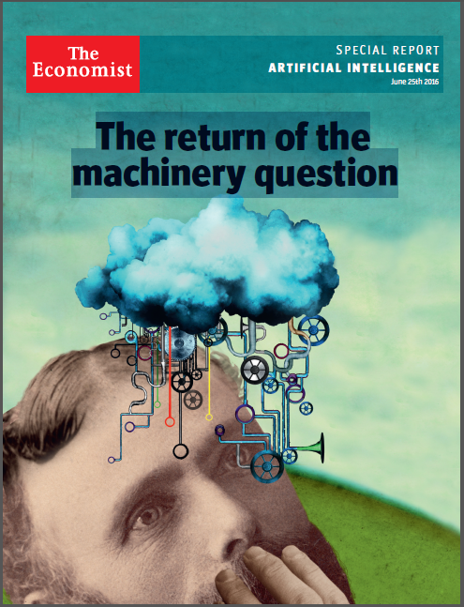
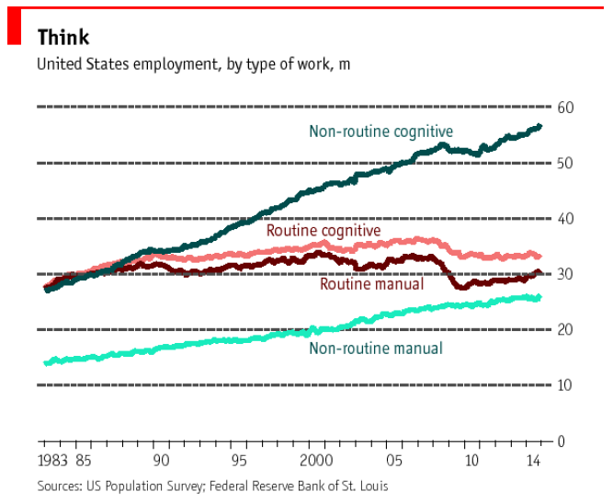
The Economist: The return of the machinery question

Slide 37


Slide 38
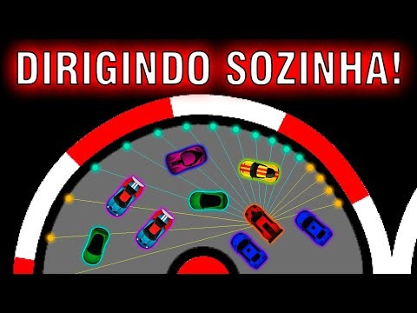

Slide 39
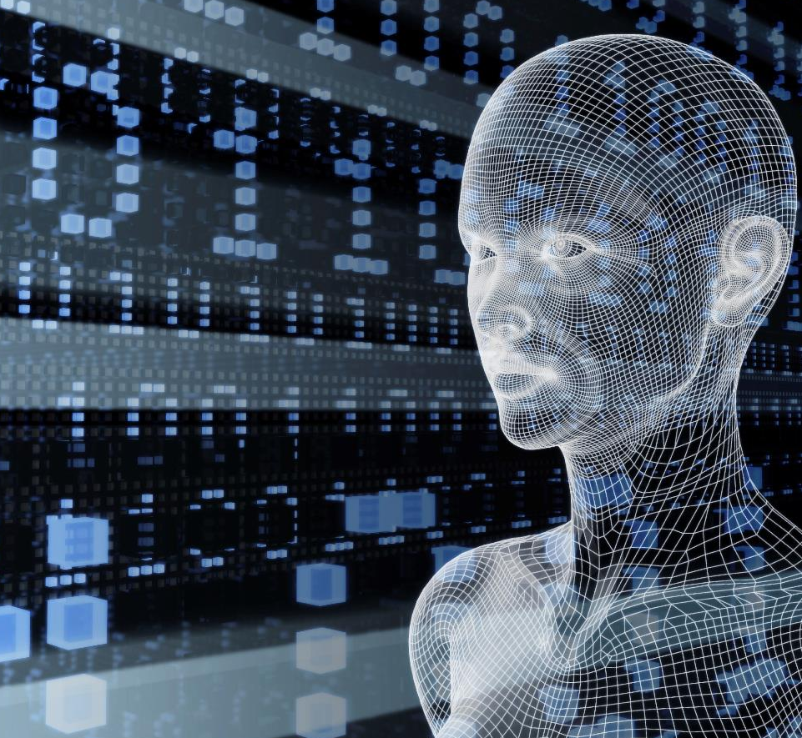
Vision
From faces to feelings, allow your apps to understand images and video
Microsoft Cognitive Services
Give your apps a human side
Speech
Hear and speak to your users by filtering noise, identifying speakers, and understanding intent
Language
Process text and learn how to recognize what users want
Knowledge
Tap into rich knowledge amassed from the web, academia, or your own data
Search
Access billions of web pages, images, videos, and news with the power of Bing APIs

Slide 40
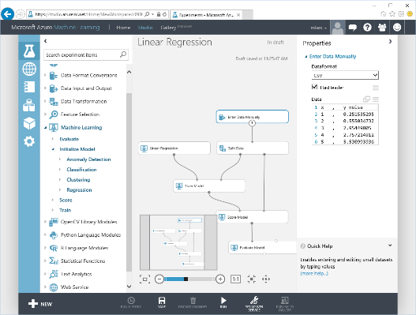
Microsoft Azure Machine Learning
Web based UI accessible from different browsers
Share|collaborate to any other ML workspace
Drag&Drop visual design|development
Wide range of ML Algorithms catalog
Extend with OSS R|Python scripts
Share|Document with IPython|Jupyter
Deploy|Publish|Scale rapidly (APIs)
Notes:
Lets look at some of the features of ML Studio

Slide 41
Machine learning flow
Define Objective
Collect Data
Prepare Data
Train Models
Evaluate Models
Publish
Manage
Integrate

Slide 42
ML Process
Historical Data
[features + labels]
Future Data
[features only]
Define Objective
Split
Training Data
[features + labels]
Testing Data
[features + labels]
Access and Understand the data
Train Model
[model learns from training data]
Score Model
[model predicts on future data]
*
Score Model
[model predicts on testing data]
Pre-processing
Prediction Results
Evaluate Model
[Compare predicted results and true labels]
*Depending largely on size/complexity, may want to do pre-processing and/or feature/target construction before ingesting into AML Studio / AML API.

Slide 43
HOL: Apartments – 101

Slide 44
ML Process
Historical Data
[features + labels]
Future Data
[features only]
Define Objective
Split
Training Data
[features + labels]
Testing Data
[features + labels]
Access and Understand the data
Train Model
[model learns from training data]
Score Model
[model predicts on future data]
*
Score Model
[model predicts on testing data]
Pre-processing
Prediction Results
Evaluate Model
[Compare predicted results and true labels]
*Depending largely on size/complexity, may want to do pre-processing and/or feature/target construction before ingesting into AML Studio / AML API.

Slide 45
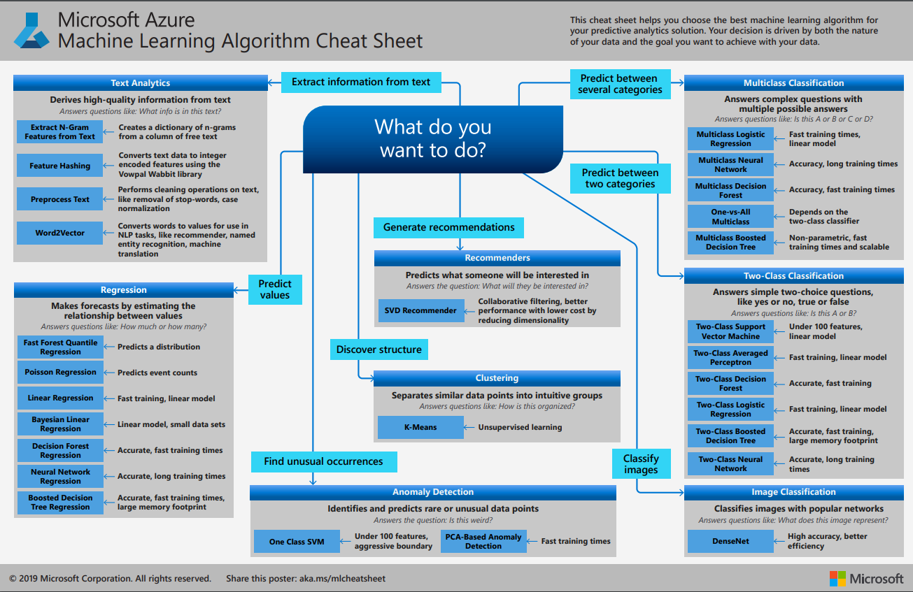

Slide 46
HOL: Apartments – 102

Slide 47
Why you need to know these algorithms?
If you want to answer a YES|NO question, it is classification
If you want to predict a numerical value, it is regression
If you want to group data into similar observations, it is clustering
If you want to recommend an item, it is recommender system
If you want to find anomalies in a group, it is anomaly detection
and many other ML algorithms for specific problem

Slide 48
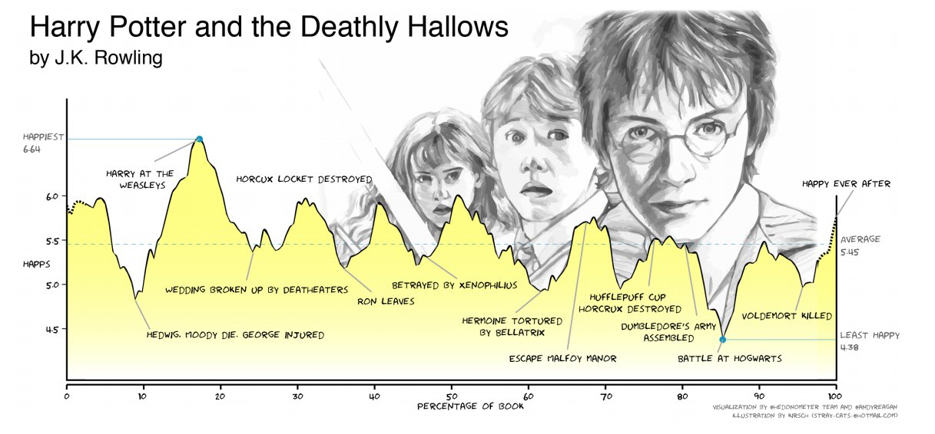
Mapping Emotions

Slide 49
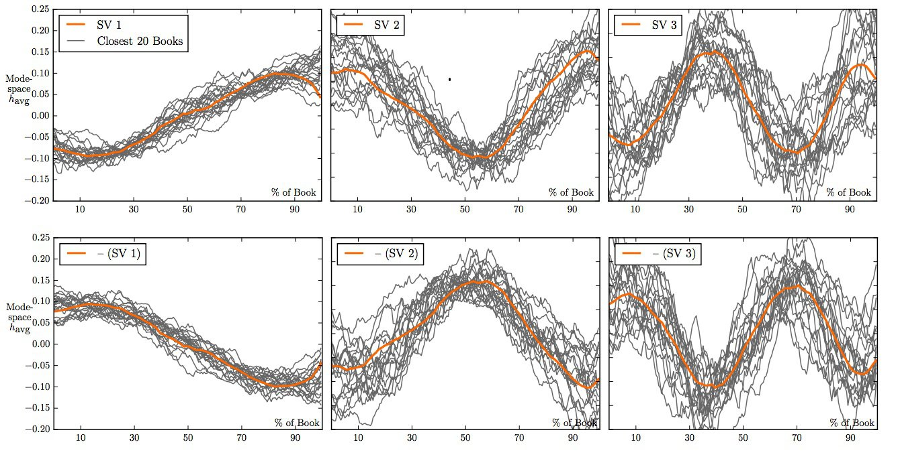
Graphics
Notes:
SV 1 – Trapos à riqueza
SV 2 - Tragédia
SV 3 – Homem no Buraco – Sherlock Holmes
SV 1 inferior – Ícaro
SV 2 Inferior – Cinderela
SV 3 Inferior – Édipo - Frankenstein

Slide 50
Reasons
Excuses to not do AI:
E: As a big company, we focus on competing, and our competitors aren’t doing this now
A: You need to lead, not follow, on massive industry transformations

Slide 51
Reasons
Excuses to not do AI:
E: We run on expertise–we don’t trust models, but trust our instincts
A: Data and instinct work together

Slide 52
Reasons
Excuses to not do AI:
E: Our data is too messy; our data projects aren’t ready yet
A: Using the data and infrastructure you have now is the best way to start

Slide 53
Reasons
Excuses to not do AI:
E: We can’t hire the right experts
A: Rather than hiring experts, develop them internally

Slide 54
Resources
Azure Machine Learning web site
http://azure.microsoft.com/en-us/services/machine-learning
Azure Machine Learning documentation
http://azure.microsoft.com/en-us/documentation/services/machine-learning
Azure Machine Learning FAQ
http://azure.microsoft.com/en-us/documentation/articles/machine-learning-faq
Azure Machine Learning pricing
http://azure.microsoft.com/en-us/pricing/details/machine-learning/
Note: The Free tier does not require an Azure subscription or a credit card

Slide 55
Contact
Github
https://github.com/lcarli
Email
Lucas.decarli.ca@gmail.com

Slide 56
Q&A

Slide 57

© 2016 Microsoft Corporation. All rights reserved. Microsoft, Windows, and other product names are or may be registered trademarks and/or trademarks in the U.S. and/or other countries.
The information herein is for informational purposes only and represents the current view of Microsoft Corporation as of the date of this presentation. Because Microsoft must respond to changing market conditions, it should not be interpreted to be a commitment on the part of Microsoft, and Microsoft cannot guarantee the accuracy of any information provided after the date of this presentation. MICROSOFT MAKES NO WARRANTIES, EXPRESS, IMPLIED OR STATUTORY, AS TO THE INFORMATION IN THIS PRESENTATION.

